Slide 1
Hotel Management system
guided by:- presented by:-
Mr. ratnesh kumar pandey rahul rathour
vibhor kumar
B.Tech.(CSE) 4th year umang saxena
invertis university shubrit bhardwaj
Bareilly

Slide 2
Containts:-
Introduction.
Dependency of project.
Advantages.
Disadvantages.
Scope.
Tkinter installation.
MySql Database.
Pillow library.
Password Forgot Feature.
Conclusion.
Reference.

Slide 3
Introduction:-
The project, Hotel Management System is GUI Based application that allows the hotel manager to handle all hotel activities online. Interactive GUI and the ability to manage hotel bookings and rooms make this system very flexible and convenient. The hotel manager is a very busy person and does not have the time to sit and manage the entire activities manually on paper. This application gives him the power and flexibility to manage the entire system from a single online system. Hotel management project provides room booking, staff management and other necessary hotel management features. The system allows the manager to post available rooms in the system. Customers can view and book room online. Admin has the power of either approving or disapproving the customer’s booking request. Other hotel services can also be viewed by the customers and can book them too. The system is hence useful for both customers and managers to portable manage the hotel activities.

Slide 4
Dependency of Project:-
Python (V. 3.10).
tkinter Module.
os module.
sys module.
cx_freeze.
mysql.connector.
Pil library.
time Date module.
random module.

Slide 5
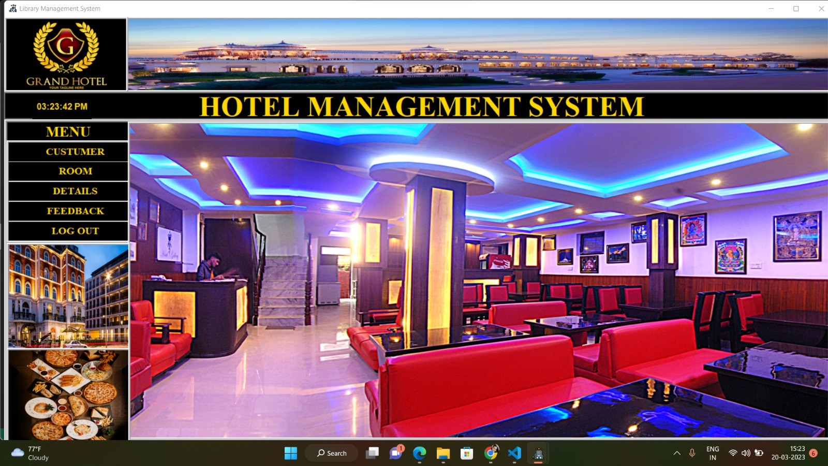
Application :-

Slide 6
Advantages:-
Sometime it happens that the rooms get booked soon when one visits the place therefore user can make advance booking using this system.
It saves user time in searching a room.
The system is useful as it calculates an exact cost of rooms for requested number of days.
It saves organization resources and expenses.
This system is effective and saves time and cost of users.

Slide 7
Disadvantages:-
The booking process usually requires a customer identity, which the system cannot detect.
It requires a reliable internet connection.

Slide 8
Scope:-
The Hotel Management System is a tool for booking rooms of Hotel through online by the customer. It provides easy management tools and easy access to the customer information. The HMS project is intended for the reservations for room that can be made through online. It will be able to automate the various operations of the Hotel. Our Hotel Management System will have three end users: Customers, Receptionist and Hotel Manager. Hotel Management System will consist of Booking Management System, Data Base Management System (DBMS) Server and Report Generator. Customers will be able to check for room’s availability, select the rooms and pay for the room. Receptionist will have access to update or modify booking details. Manager will be able to view the financial report and able to update room information such as cost and category.

Slide 9
Tkinter Installation
To install Tkinter
First Open The Command prompt and type
Well , Tkinter install successfully. Now, we can build Tkinter GUI applications.
>>> pip install Tkinter==8.6.12

Slide 10
My SQL Database:-
We use My SQL Database in our software.
By using this we saved the login information in our database for future login in perticular candidate bill.
We saved candidate Name, Candidate Number and Email also.
We can login easily when a candidate details saved in database so we use mysql for this act.

Slide 11
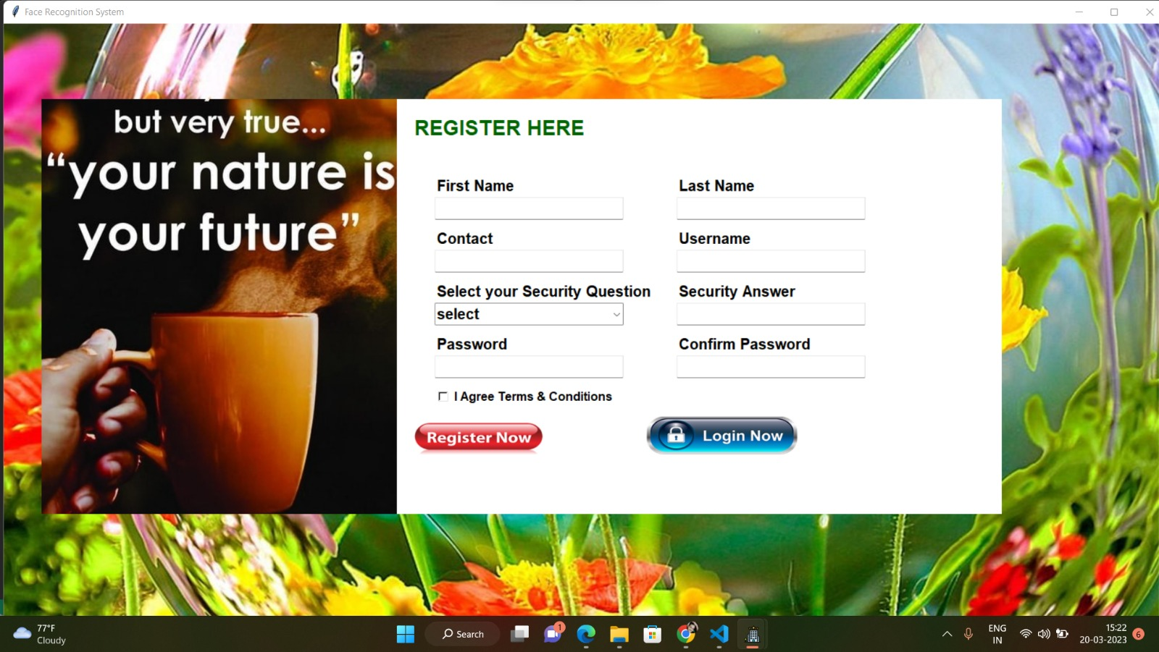
Registration Window:-

Slide 12
Pillow library :-
To install Pillow Library.
The Pillow library contains all the basic image processing functionality. You can do image resizing, rotation and transformation. Pillow module allows you to pull some statistics data out of image using histogram method, which later can be used for statistical analysis and automatic contrast enhancement.
>>> pip install Pillow

Slide 13
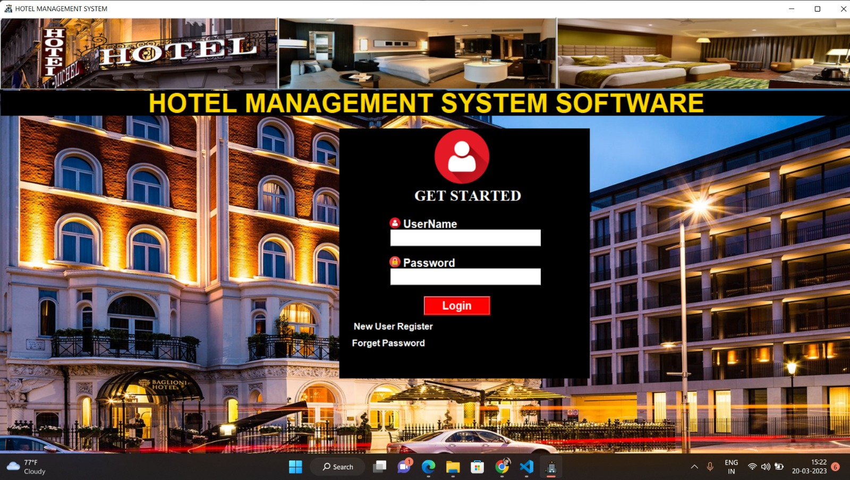
Login Page:-

Slide 14
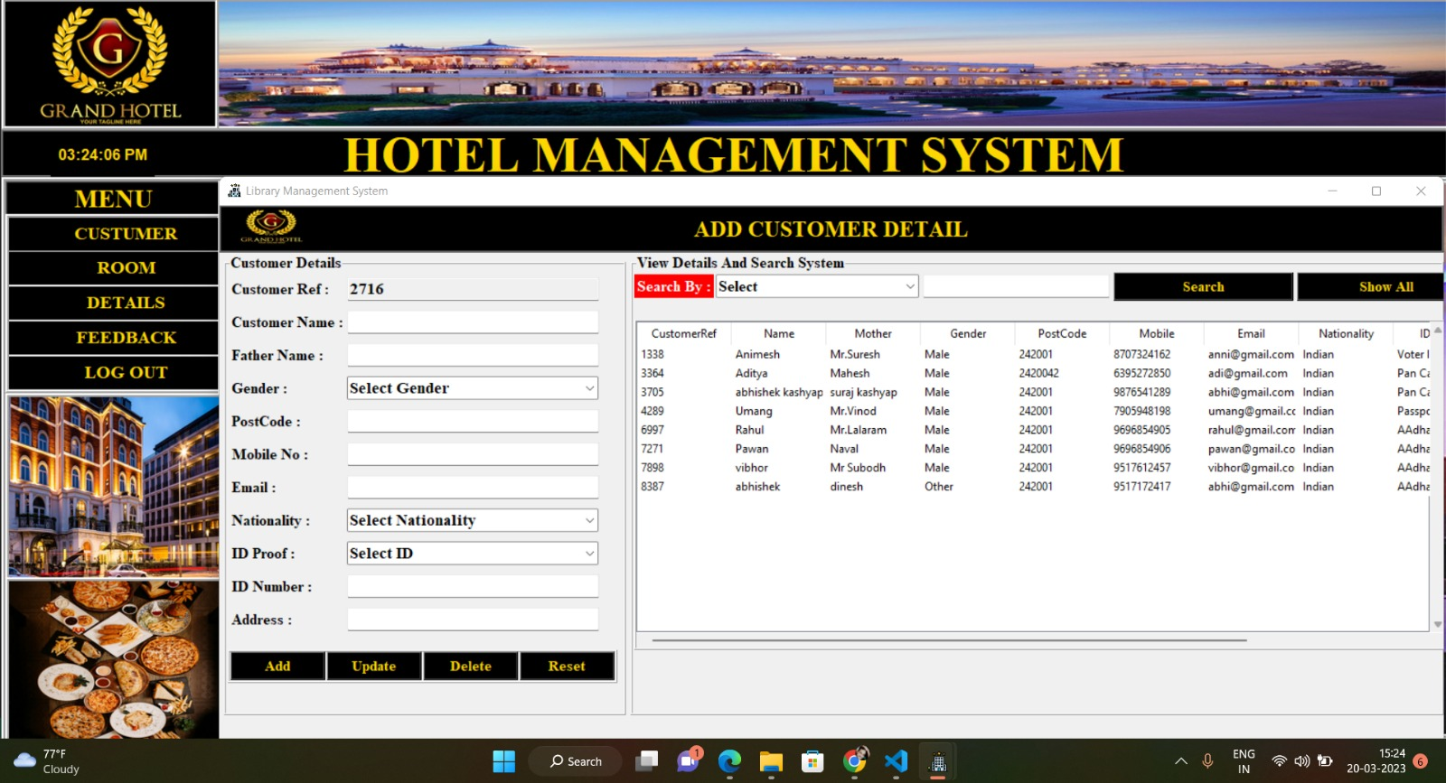
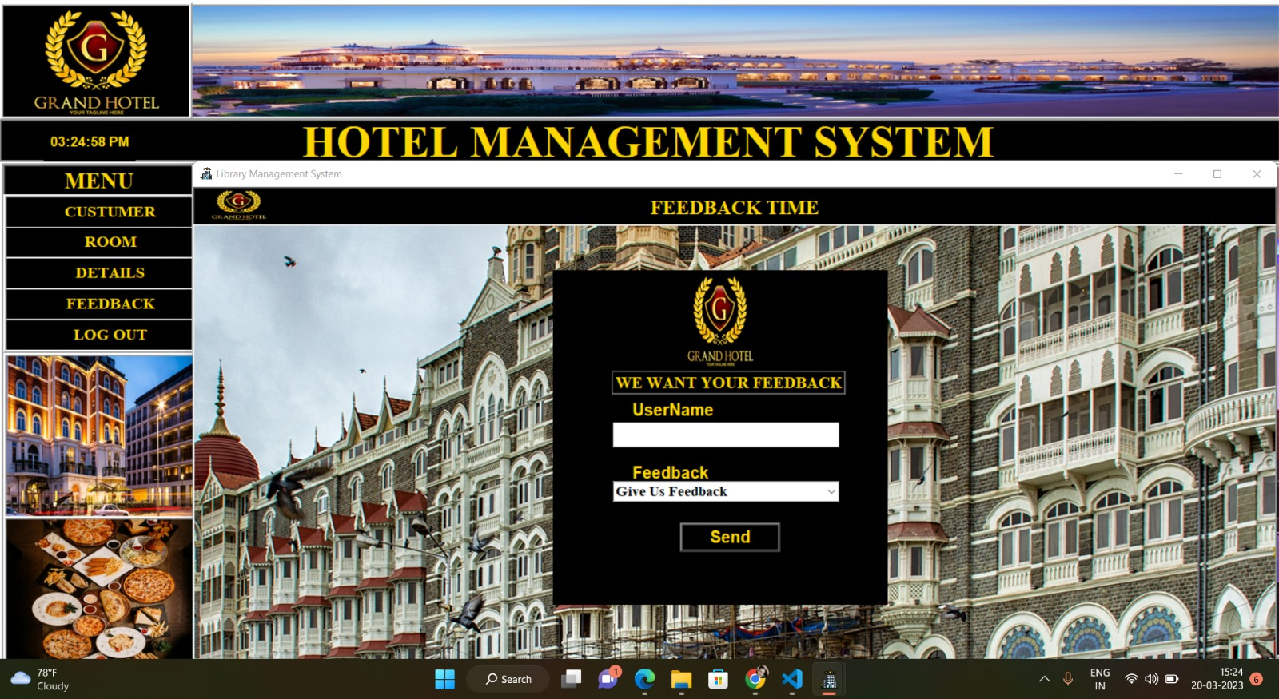
Costumer Details adding Page:-

Slide 15
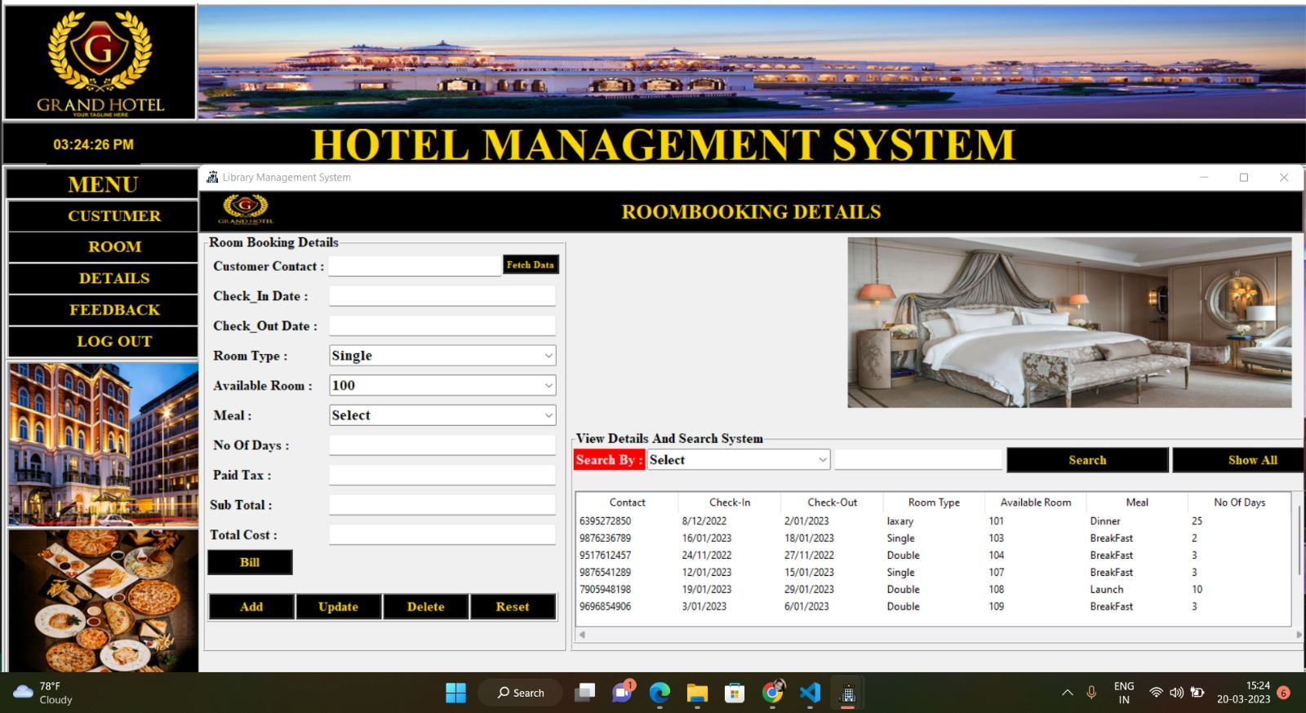
Room Booking Detail Adding Page:-

Slide 16
Password Forgot Feature:-
Here in this software password forgot feature is also available. so User use this feature if they forget their password.
This feaure is used by Security Question. When user create their profile in this page at that time a security question and answer also they saved in their account. So at that time when user forget their password they can forget their password by using this feature.

Slide 17
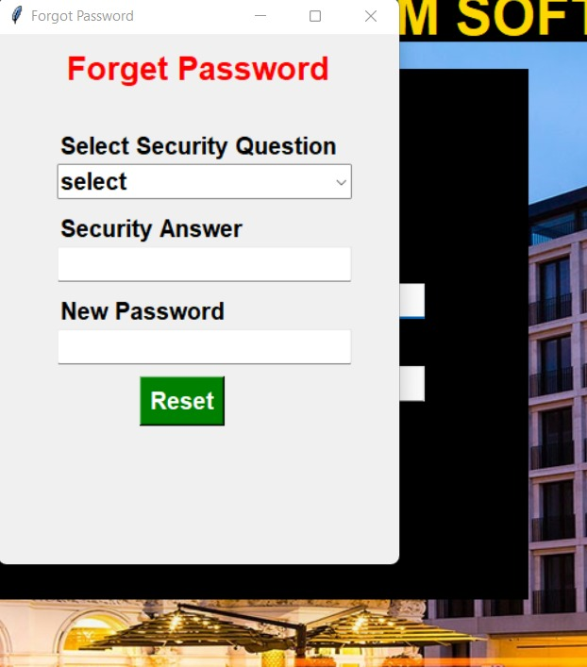
Password Forgot Page :-

Slide 18
Feedback Page:-

Slide 19
Conclusion:-
The conclusion of this project is A Hotel management system is a computerized management system. The proposed system will keep a track of Workers, Recidents, Accounts and generation of report. This project has GUI based software that will help in storing, updating and retrieving the information through various user-friendly menu-driven modules. Main objective of this project is to provide solution for hotel to manage most there work using computerized process. This software application will help admin to handle customers information, room allocation details, payment details, billing information.etc. Detailed explanation about modules and design are provided in project documentation. The existing system is a manually maintained system. All the Hotel records are to be maintained for the details of each customers, Fee details, Room Allocation etc.

Slide 20
Reference:-

Slide 21
Thank you

